Slide 1
Digital Audio Fundamentals

Slide 2
What is Sound?
Sound is when air molecules are disturbed and set in motion
Three stages of sound
Creation
Transmission
Reception

Slide 3
Parameters of sound
Amplitude
The amount of energy in the sound
Waveform
The shape of a regular vibration
Frequency
Speed of regular vibration (vibs / sec)
Spectrum
The distribution of component frequencies

Slide 4

Waveform
Frequency = number of complete waveforms per sec
Unit of measurement = Hz
kHz is 1000 Hz

Slide 5
Waveform
Amplitude => height of waveform
Measured as Intensity (Watts/m²)
Threshold of hearing is 10⁻¹² W/m² (or 0 dB)
Threshold of pain is 1 W/m² (or 120 dB)

Slide 6
Frequency / Pitch
Perception of Frequency is exponential
Pitch is the ratio of two frequencies
A4 => 440 Hz
A5 => 880 Hz
2:1 is Octave
3:2 is Fifth

Slide 7
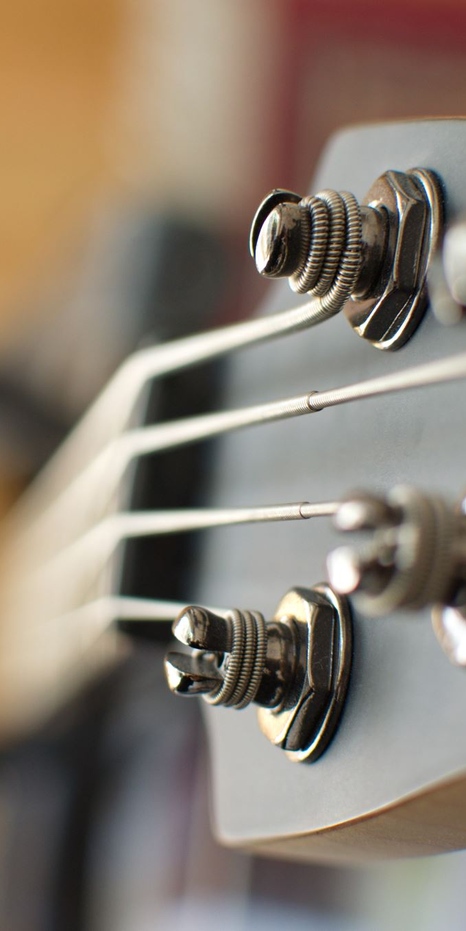
The Analog Process
Reception of Sound
Human eardrum is moved by air vibrations
Eardrum moves “analogously” to the sound

Slide 8
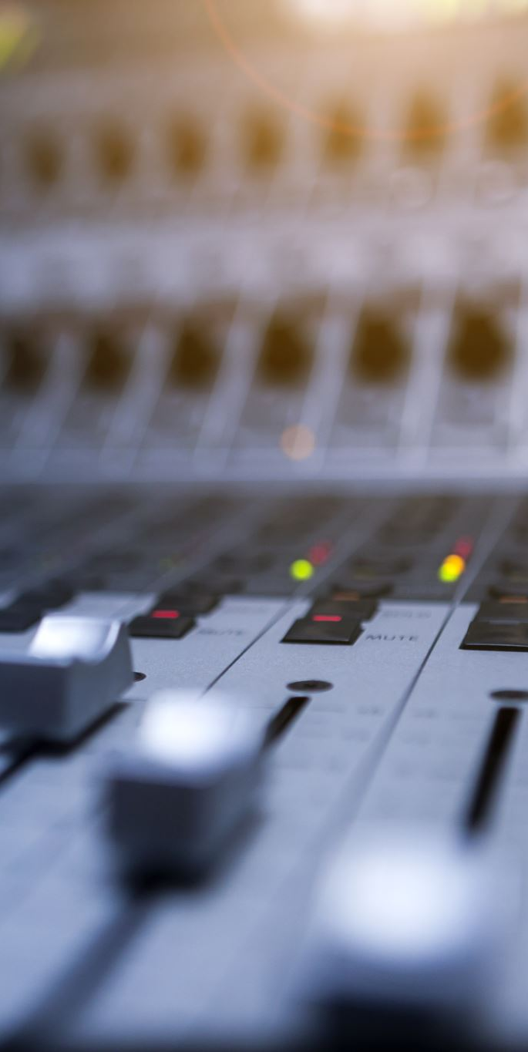
Analog Recordings
Microphone has diaphragm with magnet attached
As diaphragm moves “analogously” to sound, moving magnets create “analog” electronic signal
Signal travels down cable to magnetic tape or an audio interface

Slide 9
Digitizing Sound
When analog signal is recorded digitally:
Signal enters an Analog-to-Digital-Converter (ADC)
Measures instantaneous amplitude of input signal
Outputs stream of numbers

Slide 10
Digital Audio

Slide 11
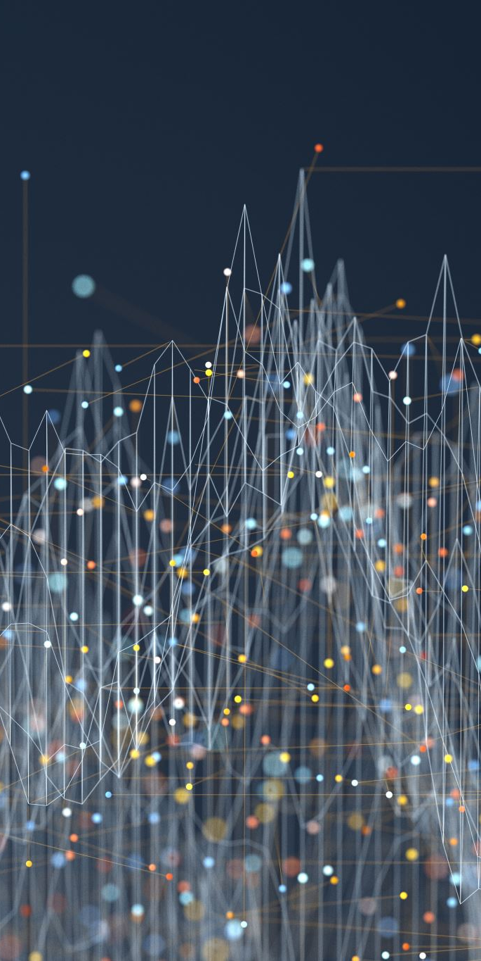
Digital vs Analog
Analog is continuous
Digital is discrete
Need lots of “samples” of the analog signal
Need good representation of amplitude values

Slide 12
Terminology for Digital Audio
Sampling Rate
The number of samples / sec the ADC or DAC processes
Sampling Rates for
CD = 44,100 Hz (44.1 kHz)
DVD = 48,000 Hz (48 kHz)

Slide 13
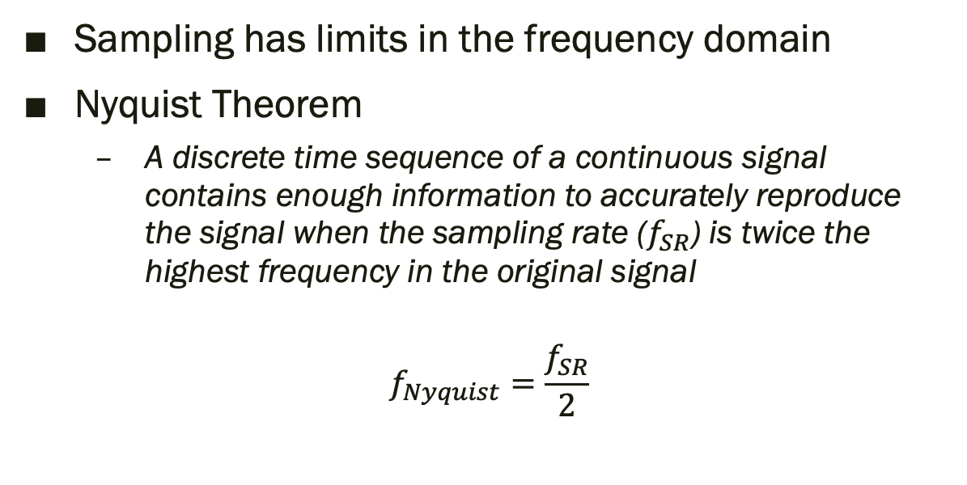
Sampling Rate Errors
Sampling has limits in the frequency domain
Nyquist Theorem
A discrete time sequence of a continuous signal contains enough information to accurately reproduce the signal when the sampling rate ($f_{SR}$) is twice the highest frequency in the original signal
$$f_{Nyquist}=\frac{f_{SR}}{2}$$

Slide 14
Sampling Rate Errors
Nyquist Rate - The minimum acceptable sampling rate (2 * frequency).
Nyquist Frequency - The highest frequency component that can be correctly sampled.

Slide 15
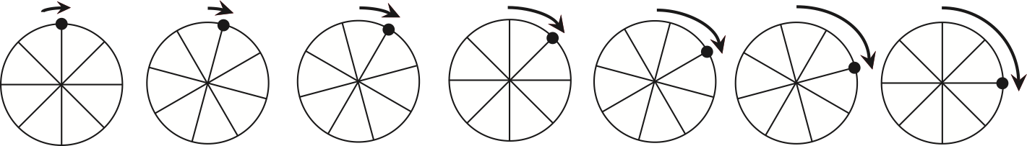
SR Error: Aliasing
“Wagon-wheel” effect
As wheel moves faster, it appears to move faster
As wheel speed approaches Nyquist limit, wheel appears to slow down, stop and then reverse

Slide 16
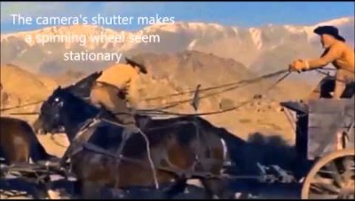
The Wagon Wheel Effect

Slide 17
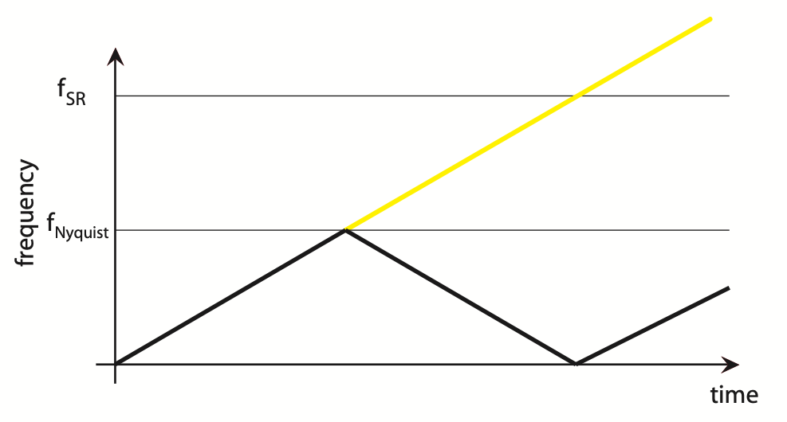

Aliasing Effect
As measured frequency rises past $f_{Nyquist}$ the playback frequency decreases at same rate

Slide 18
Terminology for Digital Audio
Resolution or bit-size
The size in bits of each sample
Binary storage is in 0s and 1s (bits)
8-bit datum => 0010 0111
possible states / values
only 256 (2⁸) values between -1 and 1
16-bit datum => 0101 1101 1111 0110
65,538 possible values between -1 and 1

Slide 19
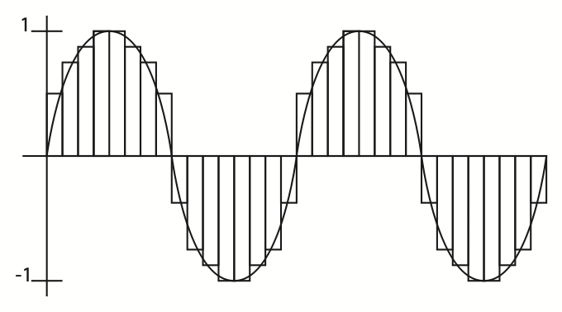
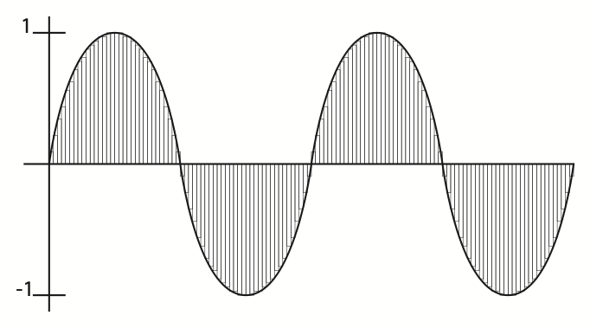
Quantization Error
Low bit size => high quantization error
High bit size => low quantization error

Slide 20
Quantization Error
Bit Depth - The number of bits used for each sample which determines the precision with which you can represent the sample amplitudes.
Distortion - The unwanted part of the audio signal that is related to the true signal.

Slide 21
More Terms To Know
Gain – Initial volume setting of a sound source.
Boost – Raising the gain amount.
Attenuate – Lowering the gain amount.
Phase – The polarity of a signal and how it relates to the polarity of another signal.
Bounce – Rendering a digital audio signal into a new digital audio file.

Slide 22
More Terms To Know
Plugin – Small application that runs inside of your DAW that processes audio in some way, either as an effect or some kind of utility tool.
Root Mean Square (RMS) – The average loudness of a signal
Decibel – Unit of measurement that describes the loudness of a signal

